Slide 1
Computer Networks
Transport Layer
Mayank Pandey

Slide 2
Objectives
understand principles behind transport layer services:
multiplexing/demultiplexing
reliable data transfer
flow control
congestion control
learn about transport layer protocols in the Internet:
UDP: connectionless transport
TCP: connection-oriented transport
TCP congestion control

Slide 3

Transport services and protocols
application
transport
network
data link
physical
provide logical communication between app processes running on different hosts
transport protocols run in end systems
send side: breaks app messages into segments, passes to network layer
rcv side: reassembles segments into messages, passes to app layer
more than one transport protocol available to apps
Internet: TCP and UDP
logical end-end transport
application
transport
network
data link
physical

Slide 4
Internet transport-layer protocols
reliable, in-order delivery (TCP)
congestion control
flow control
connection setup
unreliable, unordered delivery: UDP
no-frills extension of “best-effort” IP
services not available:
delay guarantees
bandwidth guarantees
application
transport
network
data link
physical
network
data link
physical
network
data link
physical
logical end-end transport
network
data link
physical
network
data link
physical
network
data link
physical
network
data link
physical
application
transport
network
data link
physical

Slide 5
Multiplexing/demultiplexing
Demultiplexing at rcv host:
Multiplexing at send host:
delivering received segments
to correct socket
gathering data from multiple
sockets, enveloping data with
header (later used for
demultiplexing)
= socket
= process
application
application
application
P4
P3
P1
P2
P1
transport
transport
transport
network
network
network
link
link
link
physical
physical
physical
host 1
host 2
host 3

Slide 6
How demultiplexing works
host receives IP datagrams
each datagram has source IP address, destination IP address
each datagram carries 1 transport-layer segment
each segment has source, destination port number
host uses IP addresses & port numbers to direct segment to appropriate socket
32 bits
source port #
dest port #
other header fields
application
data
(message)
TCP/UDP segment format

Slide 7
Connectionless demultiplexing
when host receives UDP segment:
checks destination port number in segment
directs UDP segment to socket with that port number
IP datagrams with different source IP addresses and/or source port numbers directed to same socket
create sockets with host-local port numbers:
DatagramSocket mySocket1 = new DatagramSocket(12534);
DatagramSocket mySocket2 = new DatagramSocket(12535);
when creating datagram to send into UDP socket, must specify
(dest IP address, dest port number)

Slide 8
Connectionless demux (cont)
DatagramSocket serverSocket = new DatagramSocket(6428);
P2
P1
P3
P1
SP: 6428
SP: 6428
DP: 9157
DP: 5775
SP: 9157
SP: 5775
client
IP: A
DP: 6428
server
IP: C
DP: 6428
Client
IP:B
SP provides “return address”

Slide 9
Connection-oriented demux
TCP socket identified by 4-tuple:
source IP address
source port number
dest IP address
dest port number
recv host uses all four values to direct segment to appropriate socket
server host may support many simultaneous TCP sockets:
each socket identified by its own 4-tuple
web servers have different sockets for each connecting client
non-persistent HTTP will have different socket for each request

Slide 10
Connection-oriented demux (cont)
P1
P4
P5
P6
P2
P1
P3
SP: 5775
DP: 80
S-IP: B
D-IP:C
SP: 9157
SP: 9157
client
IP: A
DP: 80
server
IP: C
DP: 80
Client
IP:B
S-IP: A
S-IP: B
D-IP:C
D-IP:C

Slide 11
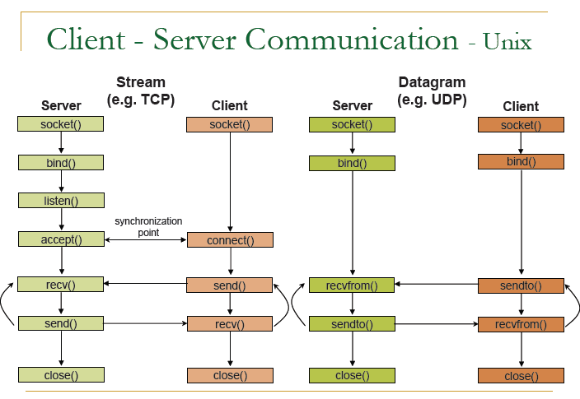
Socket programming: System Calls

Slide 12

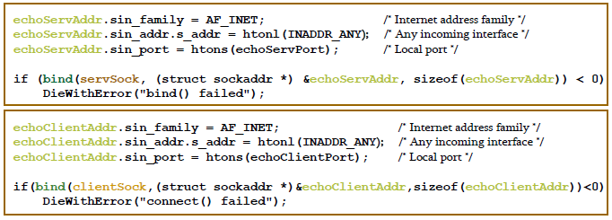
Attention: sendto() recvfrom()

Slide 13
UDP: User Datagram Protocol [RFC 768]
“no frills,” “bare bones” Internet transport protocol
“best effort” service, UDP segments may be:
lost
delivered out of order to app
connectionless:
no handshaking between UDP sender, receiver
each UDP segment handled independently of others
Why is there a UDP?
no connection establishment (which can add delay)
simple: no connection state at sender, receiver
small segment header
no congestion control: UDP can blast away as fast as desired

Slide 14
UDP: more
often used for streaming multimedia apps
loss tolerant
rate sensitive
other UDP uses
DNS
SNMP
reliable transfer over UDP: add reliability at application layer
application-specific error recovery!
32 bits
Length, in
bytes of UDP
segment,
including
header
source port #
dest port #
length
checksum
Application
data
(message)
UDP segment format

Slide 15
UDP checksum
Goal: detect “errors” (e.g., flipped bits) in transmitted segment
Sender:
treat segment contents as sequence of 16-bit integers
checksum: addition (1’s complement sum) of segment contents
sender puts checksum value into UDP checksum field
Receiver:
compute checksum of received segment
check if computed checksum equals checksum field value:
NO - error detected
YES - no error detected. But maybe errors nonetheless? More later ….

Slide 16
Internet Checksum Example
Note: When adding numbers, a carryout from the most significant bit needs to be added to the result
Example: add two 16-bit integers
1 1 1 1 0 0 1 1 0 0 1 1 0 0 1 1 0
1 1 1 0 1 0 1 0 1 0 1 0 1 0 1 0 1
1 1 0 1 1 1 0 1 1 1 0 1 1 1 0 1 1
1 1 0 1 1 1 0 1 1 1 0 1 1 1 1 0 0
1 0 1 0 0 0 1 0 0 0 1 0 0 0 0 1 1
wraparound
sum
checksum
Notes:
Kurose and Ross forgot to say anything about wrapping the carry and adding it to low order bit

Slide 17
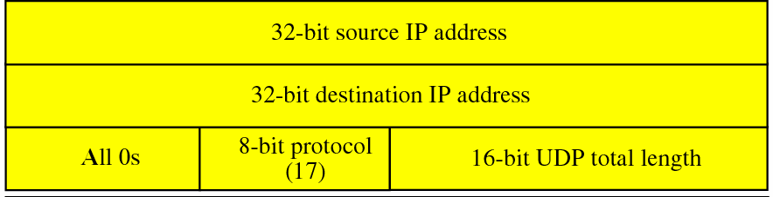
Pseudo Header
Above is the example of UDP pseudo header
This is added only for checksum calculation at the sender.
It is never sent with the packet.
Receiver also does the same. Includes Pseudo header in checksum calculation
WHY?

Slide 18
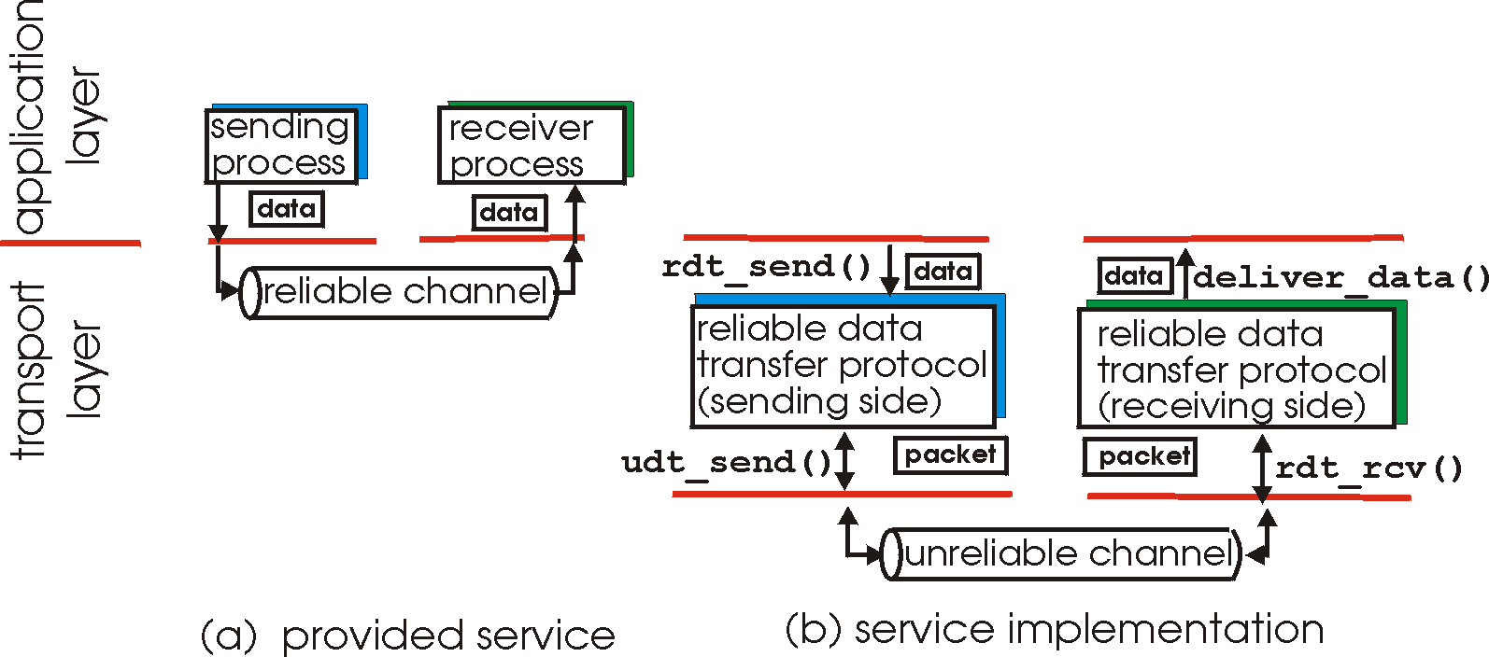
Principles of Reliable data transfer
important in app., transport, link layers
top-10 list of important networking topics!
characteristics of unreliable channel will determine complexity of reliable data transfer protocol (rdt)

Slide 19
Principles of Reliable data transfer
important in app., transport, link layers
top-10 list of important networking topics!
characteristics of unreliable channel will determine complexity of reliable data transfer protocol (rdt)

Slide 20
Principles of Reliable data transfer
important in app., transport, link layers
top-10 list of important networking topics!
characteristics of unreliable channel will determine complexity of reliable data transfer protocol (rdt)

Slide 21
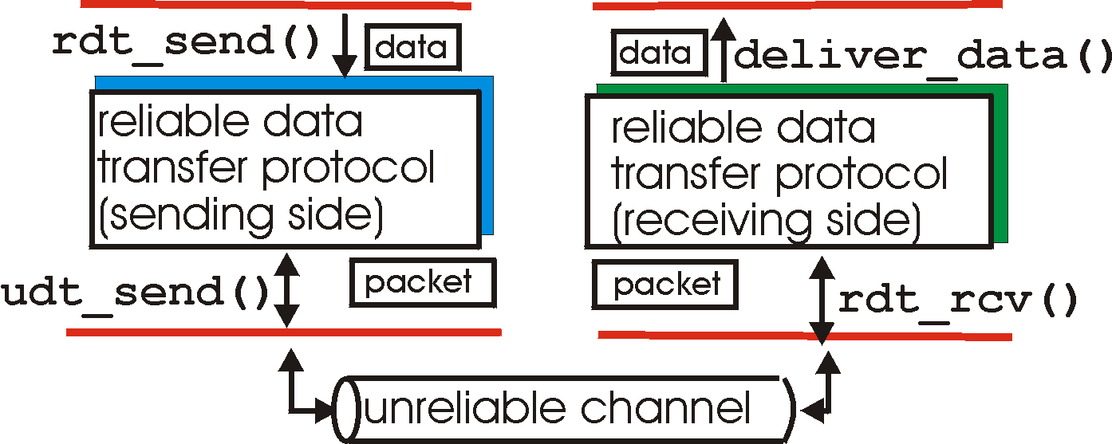
Reliable data transfer: getting started
rdt_send(): called from above, (e.g., by app.). Passed data to
deliver to receiver upper layer
deliver_data(): called by rdt to deliver data to upper
send
side
receive
side
udt_send(): called by rdt,
to transfer packet over
unreliable channel to receiver
rdt_rcv(): called when packet arrives on rcv-side of channel

Slide 22
Reliable data transfer: getting started
We’ll:
incrementally develop sender, receiver sides of reliable data transfer protocol (rdt)
consider only unidirectional data transfer
but control info will flow on both directions!
use finite state machines (FSM) to specify sender, receiver
event causing state transition
actions taken on state transition
state: when in this “state” next state uniquely determined by next event
state
1
state
2
event
actions

Slide 23
Rdt1.0: reliable transfer over a reliable channel
underlying channel perfectly reliable
no bit errors
no loss of packets
separate FSMs for sender, receiver:
sender sends data into underlying channel
receiver read data from underlying channel
Wait for call from above
rdt_send(data)
Wait for call from below
rdt_rcv(packet)
extract (packet,data)
deliver_data(data)
packet = make_pkt(data)
udt_send(packet)
sender
receiver

Slide 24
Rdt2.0: channel with bit errors
underlying channel may flip bits in packet
checksum to detect bit errors
the question: how to recover from errors:
acknowledgements (ACKs): receiver explicitly tells sender that pkt received OK
negative acknowledgements (NAKs): receiver explicitly tells sender that pkt had errors
sender retransmits pkt on receipt of NAK
new mechanisms in rdt2.0 (beyond rdt1.0):
error detection
receiver feedback: control msgs (ACK,NAK) rcvr->sender
How do humans recover from “errors”
during conversation?

Slide 25
Rdt2.0: channel with bit errors
underlying channel may flip bits in packet
checksum to detect bit errors
the question: how to recover from errors:
acknowledgements (ACKs): receiver explicitly tells sender that pkt received OK
negative acknowledgements (NAKs): receiver explicitly tells sender that pkt had errors
sender retransmits pkt on receipt of NAK
new mechanisms in rdt2.0 (beyond rdt1.0):
error detection
receiver feedback: control msgs (ACK,NAK) rcvr->sender

Slide 26
rdt2.0: FSM specification
rdt_send(data)
sndpkt = make_pkt(data, checksum)
udt_send(sndpkt)
receiver
rdt_rcv(rcvpkt) &&
isNAK(rcvpkt)
Wait for call from above
Wait for ACK or NAK
rdt_rcv(rcvpkt) &&
corrupt(rcvpkt)
udt_send(sndpkt)
udt_send(NAK)
rdt_rcv(rcvpkt) && isACK(rcvpkt)
Λ
Wait for call from below
sender
rdt_rcv(rcvpkt) &&
notcorrupt(rcvpkt)
extract(rcvpkt,data)
deliver_data(data)
udt_send(ACK)

Slide 27
rdt2.0: operation with no errors
rdt_send(data)
snkpkt = make_pkt(data, checksum)
udt_send(sndpkt)
rdt_rcv(rcvpkt) &&
isNAK(rcvpkt)
Wait for call from above
Wait for ACK or NAK
rdt_rcv(rcvpkt) &&
corrupt(rcvpkt)
udt_send(sndpkt)
udt_send(NAK)
rdt_rcv(rcvpkt) && isACK(rcvpkt)
Wait for call from below
Λ
rdt_rcv(rcvpkt) &&
notcorrupt(rcvpkt)
extract(rcvpkt,data)
deliver_data(data)
udt_send(ACK)

Slide 28
rdt2.0: error scenario
rdt_send(data)
snkpkt = make_pkt(data, checksum)
udt_send(sndpkt)
rdt_rcv(rcvpkt) &&
isNAK(rcvpkt)
Wait for call from above
Wait for ACK or NAK
rdt_rcv(rcvpkt) &&
corrupt(rcvpkt)
udt_send(sndpkt)
udt_send(NAK)
rdt_rcv(rcvpkt) && isACK(rcvpkt)
Wait for call from below
Λ
rdt_rcv(rcvpkt) &&
notcorrupt(rcvpkt)
extract(rcvpkt,data)
deliver_data(data)
udt_send(ACK)

Slide 29
rdt2.0 has a fatal flaw!
What happens if ACK/NAK corrupted?
sender doesn’t know what happened at receiver!
can’t just retransmit: possible duplicate
Handling duplicates:
sender retransmits current pkt if ACK/NAK garbled
sender adds sequence number to each pkt
receiver discards (doesn’t deliver up) duplicate pkt
stop and wait
Sender sends one packet,
then waits for receiver
response

Slide 30
rdt2.1: sender, handles garbled ACK/NAKs
rdt_send(data)
sndpkt = make_pkt(0, data, checksum)
udt_send(sndpkt)
rdt_rcv(rcvpkt) &&
( corrupt(rcvpkt) ||
isNAK(rcvpkt) )
Wait for call 0 from above
Wait for ACK or NAK 0
udt_send(sndpkt)
rdt_rcv(rcvpkt)
&& notcorrupt(rcvpkt)
&& isACK(rcvpkt)
rdt_rcv(rcvpkt)
&& notcorrupt(rcvpkt)
&& isACK(rcvpkt)
Λ
Λ
Wait for ACK or NAK 1
Wait for
call 1 from above
rdt_rcv(rcvpkt) &&
( corrupt(rcvpkt) ||
isNAK(rcvpkt) )
rdt_send(data)
udt_send(sndpkt)
sndpkt = make_pkt(1, data, checksum)
udt_send(sndpkt)

Slide 31
rdt2.1: receiver, handles garbled ACK/NAKs
rdt_rcv(rcvpkt) && notcorrupt(rcvpkt)
&& has_seq0(rcvpkt)
extract(rcvpkt,data)
deliver_data(data)
sndpkt = make_pkt(ACK, chksum)
udt_send(sndpkt)
rdt_rcv(rcvpkt) && (corrupt(rcvpkt)
rdt_rcv(rcvpkt) && (corrupt(rcvpkt)
sndpkt = make_pkt(NAK, chksum)
udt_send(sndpkt)
sndpkt = make_pkt(NAK, chksum)
udt_send(sndpkt)
Wait for
0 from below
Wait for
1 from below
rdt_rcv(rcvpkt) &&
not corrupt(rcvpkt) &&
has_seq1(rcvpkt)
rdt_rcv(rcvpkt) &&
not corrupt(rcvpkt) &&
has_seq0(rcvpkt)
sndpkt = make_pkt(ACK, chksum)
udt_send(sndpkt)
sndpkt = make_pkt(ACK, chksum)
udt_send(sndpkt)
rdt_rcv(rcvpkt) && notcorrupt(rcvpkt)
&& has_seq1(rcvpkt)
extract(rcvpkt,data)
deliver_data(data)
sndpkt = make_pkt(ACK, chksum)
udt_send(sndpkt)

Slide 32
rdt2.1: discussion
Sender:
seq # added to pkt
two seq. #’s (0,1) will suffice. Why?
must check if received ACK/NAK corrupted
twice as many states
state must “remember” whether “current” pkt has 0 or 1 seq. #
Receiver:
must check if received packet is duplicate
state indicates whether 0 or 1 is expected pkt seq #
note: receiver can not know if its last ACK/NAK received OK at sender

Slide 33
rdt2.2: a NAK-free protocol
same functionality as rdt2.1, using ACKs only
instead of NAK, receiver sends ACK for last pkt received OK
receiver must explicitly include seq # of pkt being ACKed
duplicate ACK at sender results in same action as NAK: retransmit current pkt

Slide 34
rdt2.2: sender, receiver fragments
rdt_send(data)
sndpkt = make_pkt(0, data, checksum)
udt_send(sndpkt)
rdt_rcv(rcvpkt) &&
( corrupt(rcvpkt) ||
isACK(rcvpkt,1) )
Wait for call 0 from above
Wait for ACK
0
udt_send(sndpkt)
sender FSM
fragment
rdt_rcv(rcvpkt)
&& notcorrupt(rcvpkt)
&& isACK(rcvpkt,0)
rdt_rcv(rcvpkt) &&
(corrupt(rcvpkt) ||
has_seq1(rcvpkt))
Λ
Wait for
0 from below
receiver FSM
fragment
udt_send(sndpkt)
rdt_rcv(rcvpkt) && notcorrupt(rcvpkt)
&& has_seq1(rcvpkt)
extract(rcvpkt,data)
deliver_data(data)
sndpkt = make_pkt(ACK1, chksum)
udt_send(sndpkt)

Slide 35
rdt3.0: channels with errors and loss
New assumption: underlying channel can also lose packets (data or ACKs)
checksum, seq. #, ACKs, retransmissions will be of help, but not enough
Approach: sender waits “reasonable” amount of time for ACK
retransmits if no ACK received in this time
if pkt (or ACK) just delayed (not lost):
retransmission will be duplicate, but use of seq. #’s already handles this
receiver must specify seq # of pkt being ACKed
requires countdown timer

Slide 36
rdt3.0 sender
rdt_send(data)
rdt_rcv(rcvpkt) &&
( corrupt(rcvpkt) ||
isACK(rcvpkt,1) )
sndpkt = make_pkt(0, data, checksum)
udt_send(sndpkt)
start_timer
rdt_rcv(rcvpkt)
Λ
Λ
Wait for
call 0from above
Wait for ACK0
timeout
udt_send(sndpkt)
start_timer
rdt_rcv(rcvpkt)
&& notcorrupt(rcvpkt)
&& isACK(rcvpkt,1)
rdt_rcv(rcvpkt)
&& notcorrupt(rcvpkt)
&& isACK(rcvpkt,0)
stop_timer
stop_timer
Wait for ACK1
Wait for
call 1 from above
timeout
udt_send(sndpkt)
start_timer
rdt_rcv(rcvpkt)
rdt_send(data)
Λ
rdt_rcv(rcvpkt) &&
( corrupt(rcvpkt) ||
isACK(rcvpkt,0) )
sndpkt = make_pkt(1, data, checksum)
udt_send(sndpkt)
start_timer
Λ

Slide 37
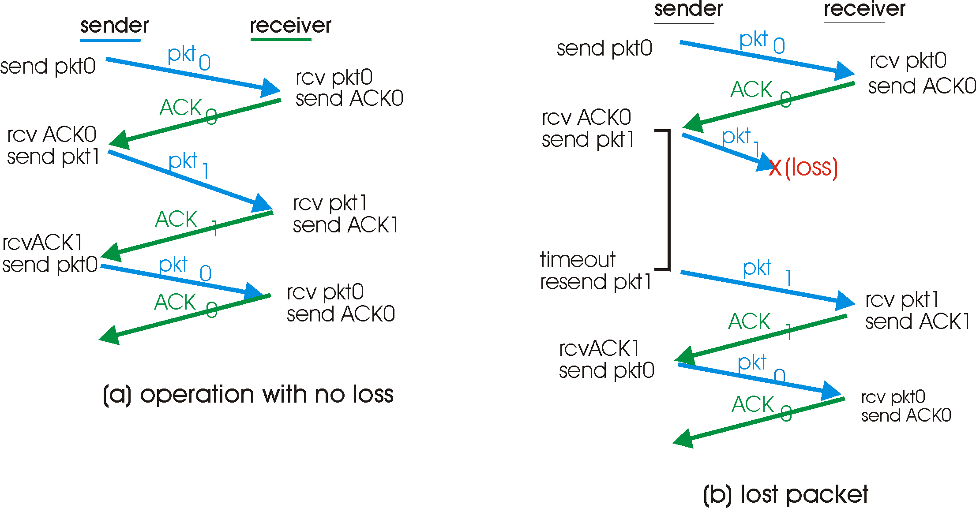
rdt3.0 in action

Slide 38
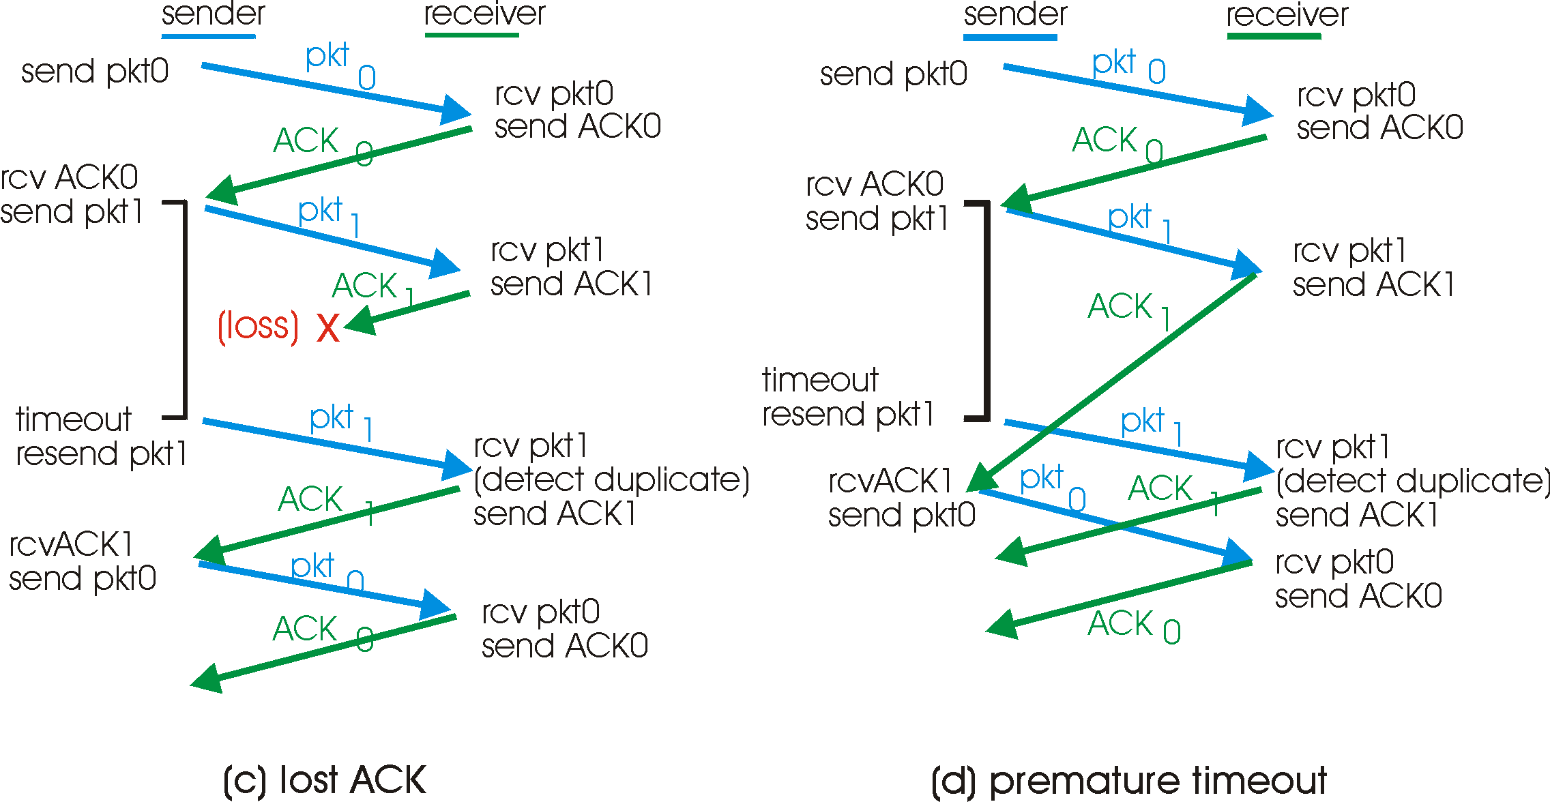
rdt3.0 in action

Slide 39
Performance of rdt3.0
rdt3.0 works, but performance stinks
ex: 1 Gbps link, 15 ms prop. delay, 8000 bit packet:
U _{sender}: utilization – fraction of time sender busy sending
if RTT=30 msec, 1KB pkt every 30 msec -> 33kB/sec thruput over 1 Gbps link
network protocol limits use of physical resources!

Slide 40
rdt3.0: stop-and-wait operation
sender
receiver
first packet bit transmitted, t = 0
last packet bit transmitted, t = L / R
first packet bit arrives
RTT
last packet bit arrives, send ACK
ACK arrives, send next
packet, t = RTT + L / R

Slide 41
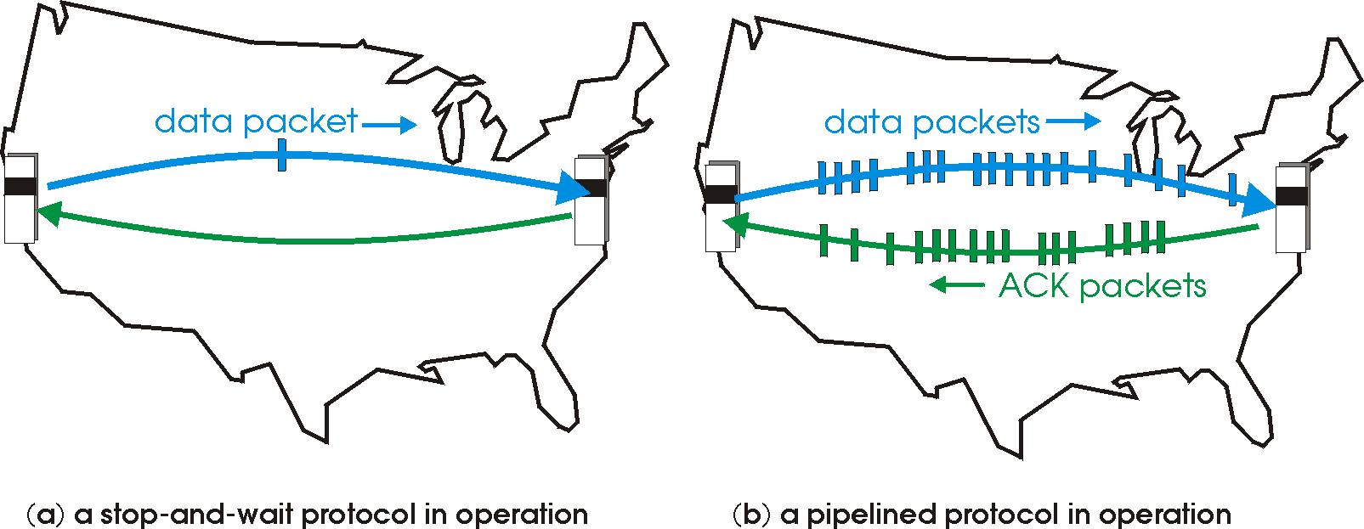
Pipelined protocols
pipelining: sender allows multiple, “in-flight”, yet-to-be-acknowledged pkts
range of sequence numbers must be increased
buffering at sender and/or receiver
two generic forms of pipelined protocols: go-Back-N, selective repeat

Slide 42
Pipelining: increased utilization
sender
receiver
first packet bit transmitted, t = 0
last bit transmitted, t = L / R
first packet bit arrives
RTT
last packet bit arrives, send ACK
last bit of 2nd packet arrives, send ACK
last bit of 3rd packet arrives, send ACK
ACK arrives, send next
packet, t = RTT + L / R
Increase utilization
by a factor of 3!

Slide 43
Pipelined Protocols
Go-back-N: big picture:
sender can have up to N unacked packets in pipeline
rcvr only sends cumulative acks
doesn’t ack packet if there’s a gap
sender has timer for oldest unacked packet
if timer expires, retransmit all unack’ed packets
Selective Repeat: big pic
sender can have up to N unack’ed packets in pipeline
rcvr sends individual ack for each packet
sender maintains timer for each unacked packet
when timer expires, retransmit only unack’ed packet

Slide 44
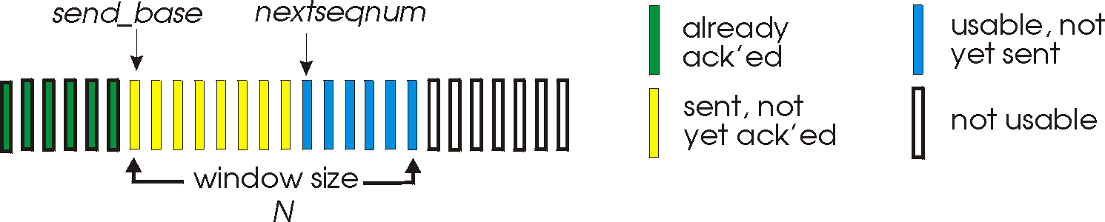
Go-Back-N
Sender:
k-bit seq # in pkt header
“window” of up to N, consecutive unack’ed pkts allowed
ACK(n): ACKs all pkts up to, including seq # n - “cumulative ACK”
may receive duplicate ACKs (see receiver)
timer for each in-flight pkt
timeout(n): retransmit pkt n and all higher seq # pkts in window

Slide 45
GBN: sender extended FSM
rdt_send(data)
if (nextseqnum < base+N) {
sndpkt[nextseqnum] = make_pkt(nextseqnum,data,chksum)
udt_send(sndpkt[nextseqnum])
if (base == nextseqnum)
start_timer
nextseqnum++
}
else
refuse_data(data)
Λ
base=1
nextseqnum=1
timeout
Wait
start_timer
udt_send(sndpkt[base])
udt_send(sndpkt[base+1])
…
udt_send(sndpkt[nextseqnum-1])
rdt_rcv(rcvpkt)
&& corrupt(rcvpkt)
rdt_rcv(rcvpkt) &&
notcorrupt(rcvpkt)
base = getacknum(rcvpkt)+1
If (base == nextseqnum)
stop_timer
else
start_timer

Slide 46
GBN: receiver extended FSM
default
udt_send(sndpkt)
rdt_rcv(rcvpkt)
&& notcurrupt(rcvpkt)
&& hasseqnum(rcvpkt,expectedseqnum)
Λ
Wait
extract(rcvpkt,data)
deliver_data(data)
sndpkt = make_pkt(expectedseqnum,ACK,chksum)
udt_send(sndpkt)
expectedseqnum++
expectedseqnum=1
sndpkt =
make_pkt(expectedseqnum,ACK,chksum)
ACK-only: always send ACK for correctly-received pkt with highest in-order seq #
may generate duplicate ACKs
need only remember expectedseqnum
out-of-order pkt:
discard (don’t buffer) -> no receiver buffering!
Re-ACK pkt with highest in-order seq #

Slide 47
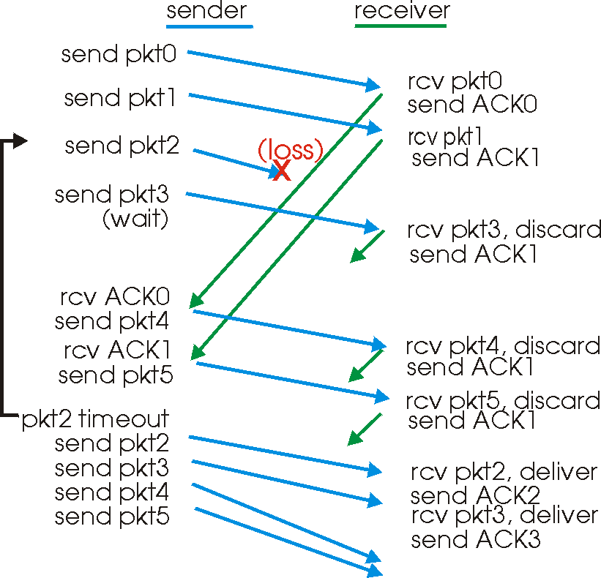
GBN in action

Slide 48
Selective Repeat
receiver individually acknowledges all correctly received pkts
buffers pkts, as needed, for eventual in-order delivery to upper layer
sender only resends pkts for which ACK not received
sender timer for each unACKed pkt
sender window
N consecutive seq #’s
again limits seq #s of sent, unACK’ed pkts

Slide 49
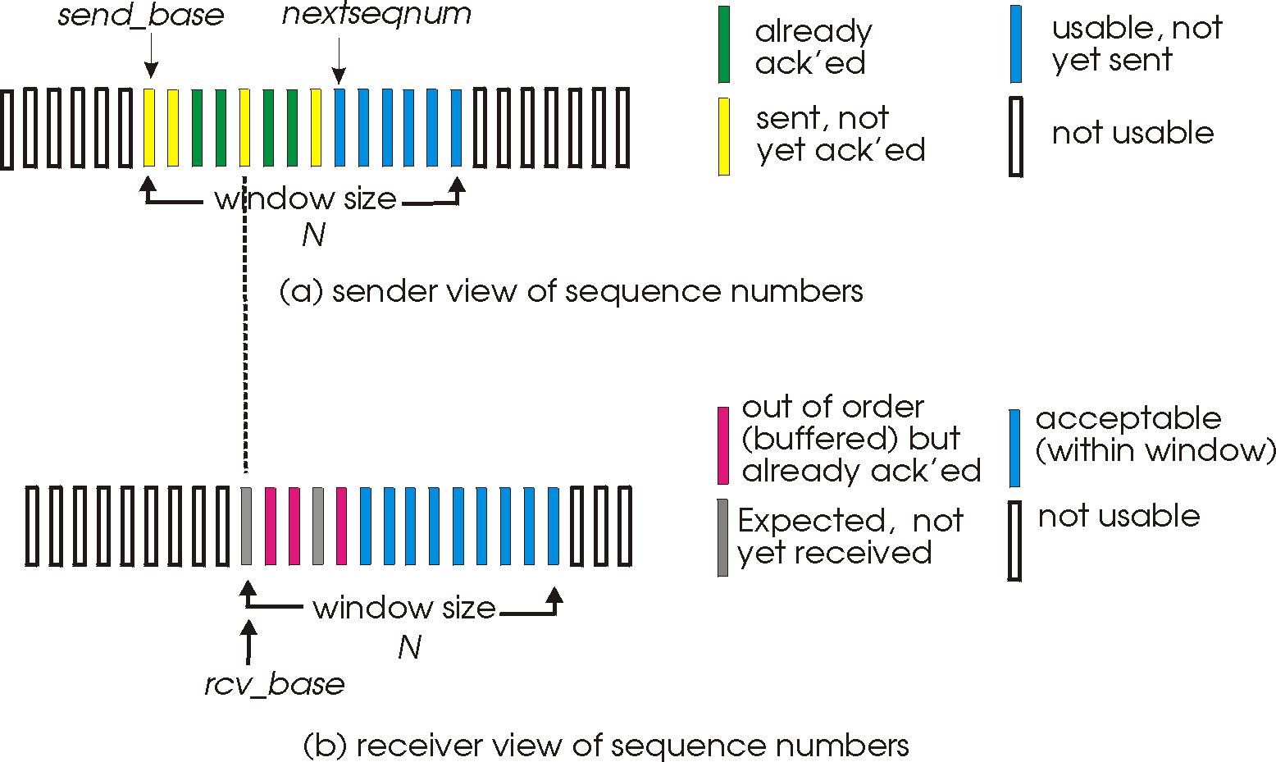
Selective repeat: sender, receiver windows

Slide 50
Selective repeat
sender
receiver
data from above :
if next available seq # in window, send pkt
timeout(n):
resend pkt n, restart timer
ACK(n) in [sendbase,sendbase+N]:
mark pkt n as received
if n smallest unACKed pkt, advance window base to next unACKed seq #
pkt n in [rcvbase, rcvbase+N-1]
send ACK(n)
out-of-order: buffer
in-order: deliver (also deliver buffered, in-order pkts), advance window to next not-yet-received pkt
pkt n in [rcvbase-N,rcvbase-1]
ACK(n)
otherwise:
ignore

Slide 51
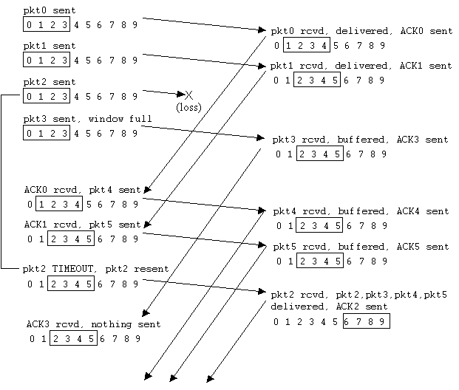
Selective repeat in action

Slide 52
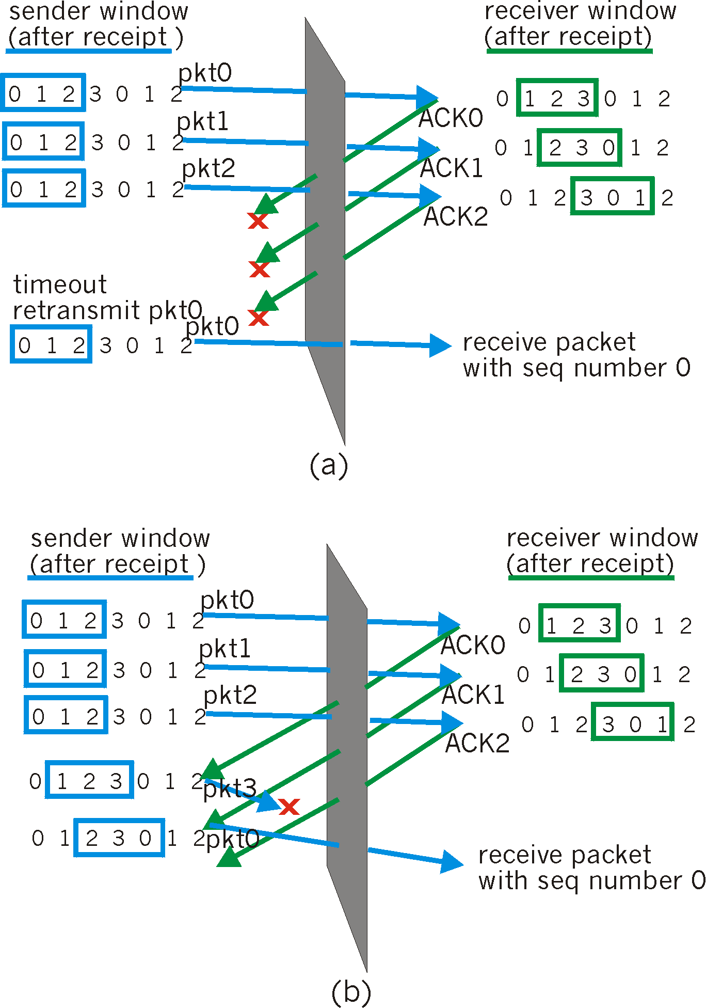
Selective repeat: dilemma
Example:
seq #’s: 0, 1, 2, 3
window size=3
receiver sees no difference in two scenarios!
incorrectly passes duplicate data as new in (a)
Q: what relationship between seq # size and window size?

